Slide 1
EES203: Geochemistry
Instructor: Anoop Ambili
Email id: anoop@iisermohali.ac.in

Slide 2
Geochemical evolution of hydrosphere

Slide 3
Factors responsible for modifying seawater chemistry
Processes capable of modifying the chemistry of seawater, besides addition of constituents by rivers, fall into six categories
Biological processes Such processes exert major controls on the concentration of recycled constituents (Ca²⁺ , HCO₃⁻,SO₄²⁻, H₄SiO₄, CO₂, O₂, NO₃⁻, and PO₄³⁻).
(2) Seafloor volcanics–seawater interaction, both high temperature (200–400°C) reactions at mid-oceanic ridge axes and off-axis low temperature reactions.
(3) Reaction of seawater with detrital solids transported from the continents. Such reactions may involve an entire detrital mineral or affect only the mineral surface by ion exchange, especially of Ca²⁺ for Na⁺. Ion exchange is particularly important for trace elements.
(4) Ocean-to-air transfer of cyclic salts: sea-salt particles blown from the ocean surface onto the land).
(5) Precipitation of evaporite and sulfide minerals, an important mechanism for the removal of Na⁺, Ca²⁺, Cl⁻, and SO₄²⁻ from seawater.
(6) Special processes that generally affect only one or two constituents. These include porewater burial of Cl⁻ and Na⁺, and a number of processes unique to the nitrogen and phosphorous cycles (nitrification, denitrification, N2 fixation, adsorption of phosphate on ferric oxides, and authigenic apatite formation).

Slide 4
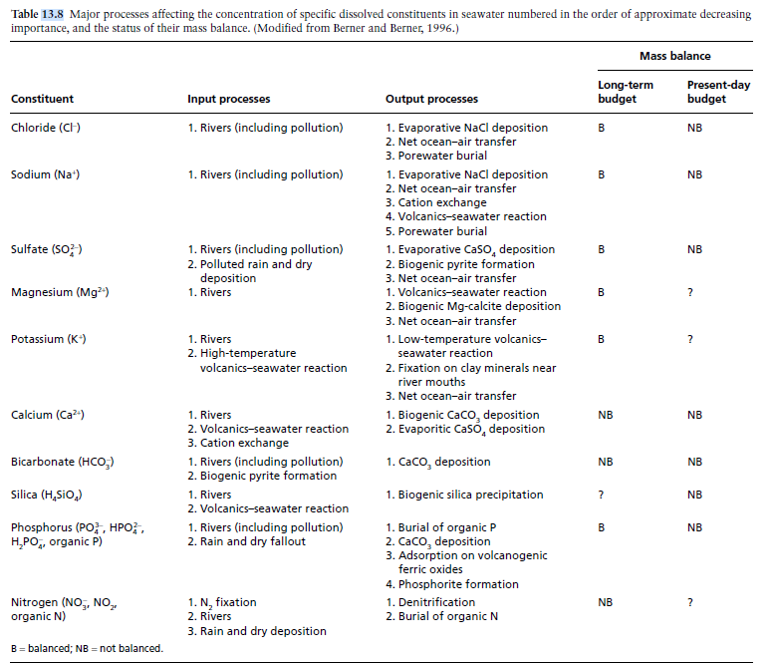
Mass balance of dissolved constituents in seawater

Slide 5
Evolution of the oceans over geologic time
Origin of the oceans
Age of the oceans:
The occurrence of chemical sediments (such as BIFs) in the 3.8-Gyr-old Isua sequence in west Greenland (Nutman et al., 1997; Whitehouse et al., 1999) is indisputable evidence that liquid water was present on the Earth by that time.
A much earlier presence of liquid water on the Earth has been inferred from the 18O-enriched oxygen isotope composition of > 3900-Myr-old magmatic zircon crystals recovered from the Jack Hills metasedimentary belt of Western Australia (Mojzsis et al., 2001; Peck et al., 2001; Cavosie et al., 2005)

Slide 6
Evolution of the oceans over geologic time
Source of waters
Sources of water in the terrestrial planets include:
Comets;
Hydrous asteroids
Phyllosilicates migrating from the asteroid belt

Slide 7
Aqueous Chemistry and role of Chemical weathering

Slide 8
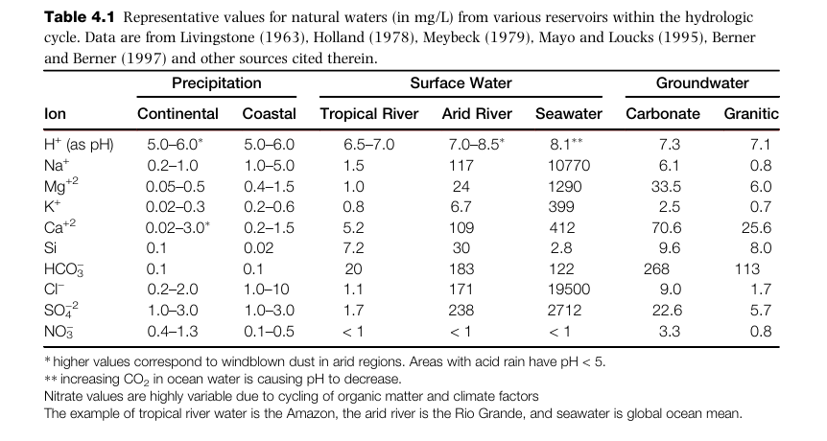

Slide 9
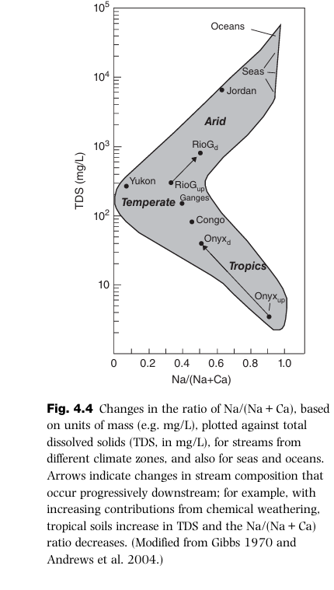
Gibbs plots

Slide 10
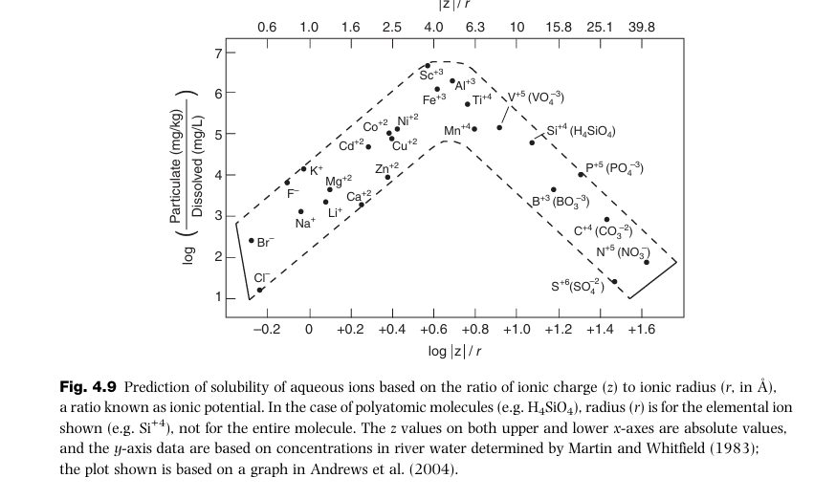
Solubility of ions
Not all ions in solution exist as simple monoatomic
ions like Ca+2 or Cl– but rather occur
charged molecules known as polyatomic
Anions or cations ( ammonium (NH4
+); uranyl (UO2
+2))

Slide 11
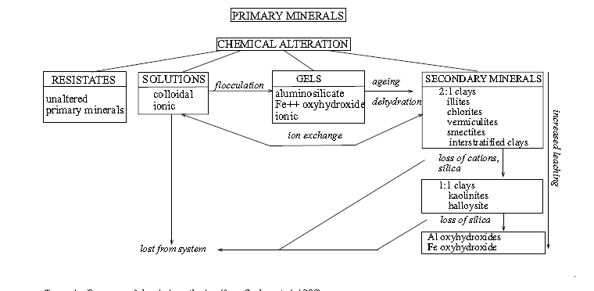
Chemical alteration

Slide 12
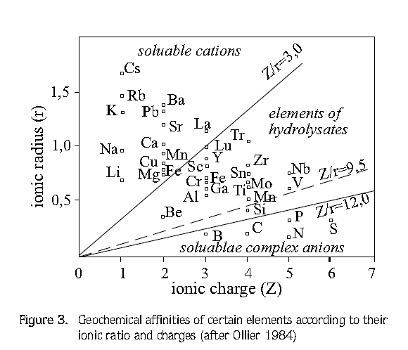
Chemical weathering

Slide 13
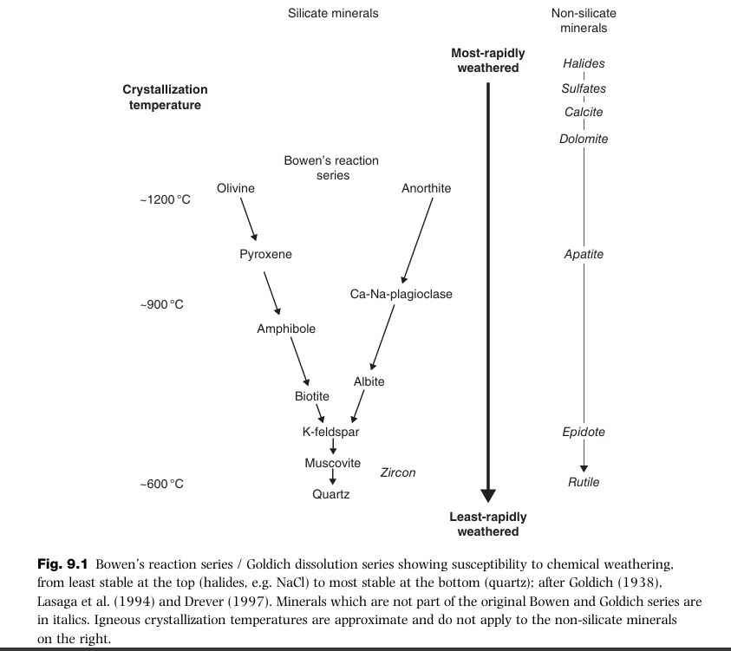
Chemical weathering series

Slide 14
Calculating weathering rates
certain major oxides, including Al₂O₃, Fe₂O₃ and TiO₂, considered as ‘immobile’
(b) Si₂O, Na₂O, K₂O, CaO and MgO, considered as ‘mobile’

Slide 15
Chemical Index of Alteration
Chemical index of alteration (CIA) commonly used to assess paleosol weathering
CIA is interpreted as a measure of the extent of the conversion of feldspar to clays
The CIA is defined as
Al₂O₃/(Al₂O₃+CaO*+Na₂O+K₂O)×100 (molar contents, with CaO* being CaO content in the silicate fraction of the sample)

Slide 16


Chemical Index of Weathering
The CIW is defined as
Source:

Slide 17
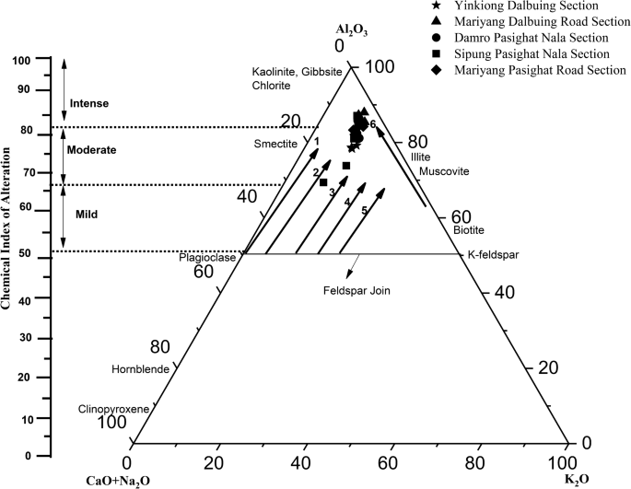
ACKN diagram for weathering
Source: Mudoi et al., 2022

Slide 18
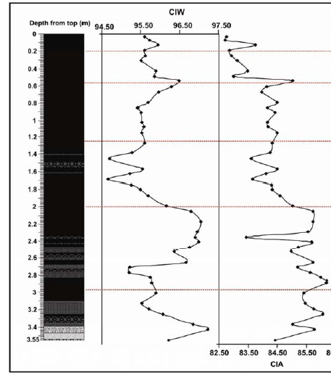
Paleoclimate reconstruction
Source: Kotlia and Joshi, 2013

